Slide 1
Processor Organization
CPU must do:
  Fetch instructions
  Interpret instructions
  Fetch data
  Process data
  Write data
CPU must have some working space (temporary storage) called registers
Notes:
22

Slide 2
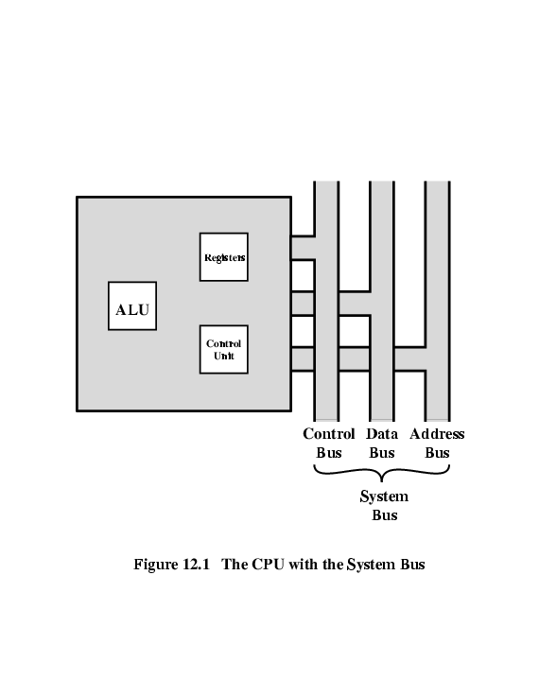
CPU With Systems Bus

Slide 3
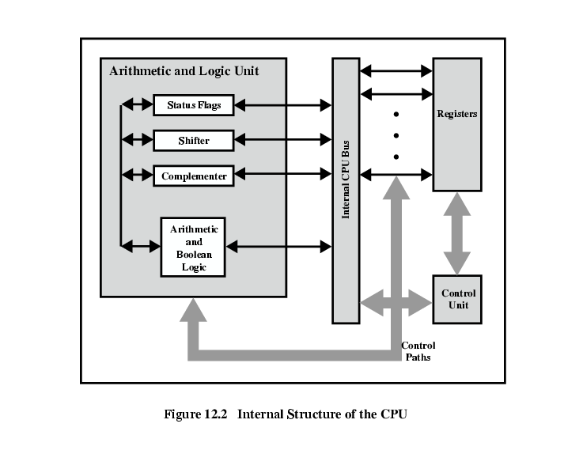
CPU Internal Structure

Slide 4
Registers
Number and function vary between processor designs
Top level of memory hierarchy (faster, smaller, and more expensive per bit)
  User Visible Registers: Enable assembly language programmer to minimize main memory references.
  Control and status registers: Used by the CU to control the operation of the processor and by operating system programs to control the execution of programs
Notes:
23

Slide 5
Program Status Word (PSW)
A set of bits
Includes Condition Codes such as:
  Sign
  Zero
  Carry
  Equal
  Overflow
Interrupt enable/disable
Supervisor
Notes:
31

Slide 6
Memory Address Register (MAR)
  Connected to address bus
  Specifies address for read or write operand
Memory Buffer Register (MBR)
  Connected to data bus
  Holds data to write or last data read
Program Counter (PC)
  Holds address of next instruction to be fetched
Instruction Register (IR)
  Holds last instruction fetched

Slide 7
Data Flow* (Instruction Fetch)
PC contains address of next instruction
Address moved to MAR
Address placed on address bus
Control unit requests memory read
Result placed on data bus, copied to MBR, then to IR
Meanwhile PC incremented by 1
* CPU dependent

Slide 8

Data Flow (Fetch Diagram)

Slide 9
Data Flow (Data Fetch)
IR is examined
If indirect addressing, indirect cycle is performed
  Right most N bits of MBR (address reference) transferred to MAR
  Control unit requests memory read
  Result (address of operand) moved to MBR

Slide 10

Data Flow (Indirect Diagram)

Slide 11
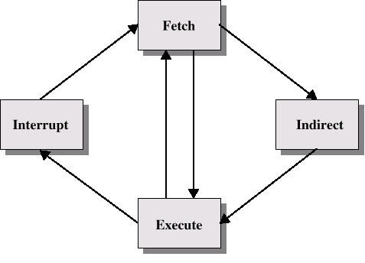
Instruction Cycle with Indirect

Slide 12

Instruction Cycle State Diagram

Slide 13
Data Flow (Execute)
May take many forms
Depends on instruction being executed
May include:
  Memory read/write
  Input/Output read/write
  Register transfers
  ALU operations

Slide 14
Data Flow (Interrupt)
Current PC saved to allow resumption after interrupt
Contents of PC copied to MBR
Special memory location (e.g. stack pointer) loaded to MAR
MBR written to memory
PC loaded with address of interrupt handling routine (OS)
Next instruction (first of interrupt handler) can be fetched

Slide 15

Data Flow (Interrupt Diagram)

Slide 16
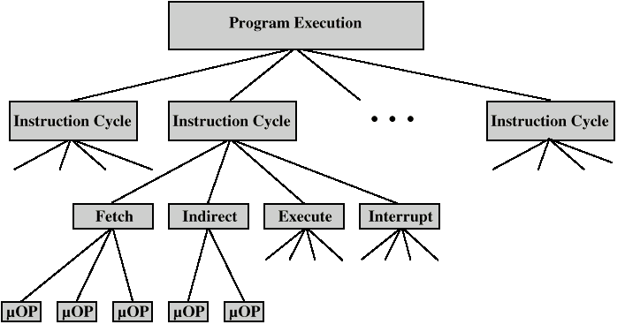
Constituent Elements of Program Execution

Slide 17
Micro-Operations
A computer executes a program
Fetch/execute cycle
Each cycle has a number of steps called micro-operations
Each micro-operation does very little e.g.:
  a transfer between registers
  a transfer between a register and an external bus
  a simple ALU operation

Slide 18
Fetch Sequence (symbolic)
(tx = time unit/clock cycle)
t1: MAR ← PC
t2: MBR ← memory
PC ← (PC) +1 * *
t3: IR ← (MBR)
* (May need additional micro-operations if ALU involved)
* PC ← (PC) + I, where I is the instruction length

Slide 19
Rules for Micro-Operations Grouping
Proper sequence must be followed
  MAR ← PC must precede MBR ← memory, why?
Conflicts must be avoided
  MBR ← memory & IR ← MBR must not be in same cycle , why?
* Write down another fetch sequence.

Slide 20
Indirect Cycle
t1: MAR ← IR_{address} - address field of IR
t2: MBR ← memory
t3: IR_{address} ← MBR_{address}
Note:
  Assume a one-address instruction format, with direct and indirect addressing allowed
  MBR contains an address
  IR is now in same state as if direct addressing had been used

Slide 21
Interrupt Cycle*
t1: MBR ← PC
t2: MAR ← save-address
PC ← routine-address
t3: memory ← MBR
* This is a minimum (OS or machine dependent):
  May be additional micro-operations to get addresses
  saving context is done by interrupt handler routine

Slide 22
Execute Cycle (ADD)
Different for each instruction
e.g. ADD R1,X (add the contents of location X to Register R1 , result in R1)
t1: MAR ← IR_{address}
t2: MBR ← memory
t3: R1 ← R1 + MBR
Note: This is a simplified example. Additional micro-operations may be required

Slide 23
Execute Cycle (ISZ)
ISZ X - increment and skip if zero (the content of location X is incremented by 1. If the result is 0, the next instruction is skipped)
t1: MAR ← IR_{address}
t2: MBR ← memory
t3: MBR ← MBR + 1
t4: memory ← MBR
if (MBR) == 0 then PC ← PC + 1
Note: if is a single micro-operation

Slide 24
Execute Cycle (BSA)
BSA X - Branch and save address (subroutine call: address of instruction following BSA is saved in X, Execution continues from X+K)
t1: MAR ← IR_{address}
MBR ← PC
t2: PC ← IR_{address}
memory ← MBR
t3: PC ← PC + K

Slide 25
Instruction Cycle Summary
Each sub-cycle decomposed into sequence of elementary micro-operations
one sequence of micro-operations each for the fetch, indirect, and interrupt sub-cycles
Execute sub-cycle: One sequence of micro-operations for each instruction (opcode)

Slide 26
RQ:12.4
P: 12.1, 12.2, 12.3, 12.4

